Slide 1
Who Has the Problem?
For: Parents of Teen Drivers
[Target customer]
Who has: Wants to keep their new drivers safe
[Significant problem/need]
My solution provides:
Peace of mind; added feelings of safety/ security
[Key benefit]
Unlike: Not knowing how their teen is driving or using solutions like life360 or find my to guess
[How customer addresses issue today]

Slide 2
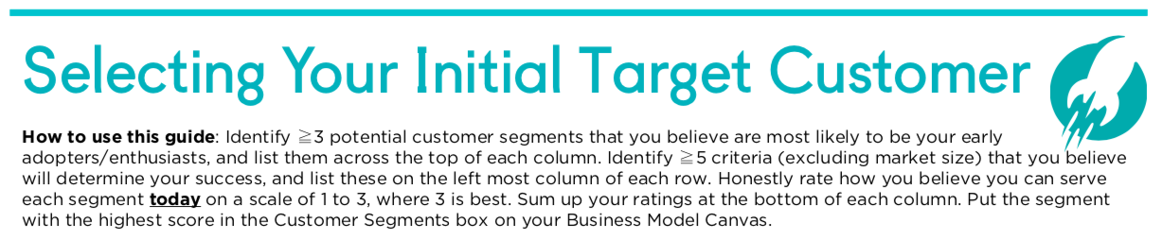
Segment Criteria | Parents of teenage drivers | Rental Car Company Risk Managers | Rideshare Drivers | Door to door business owners | Insurance Companies
Ease of integration | 3 | 1 | 1 | 1 | 2
Willingness to try new solution | 3 | 2 | 2 | 3 | 3
Willingness to pay | 2 | 2 | 2 | 2 | 2
Decision maker | 3 | 3 | 3 | 3 | 3
Sales Complexity | 1 | 3 | 1 | 1 | 3
Efficacy of existing solutions | 1 | 3 | 1 | 3 | 3
TOTAL | 13 | 14 | 10 | 13 | 16

Slide 3
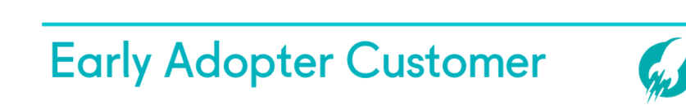

Tech savvy
Lives in the city
Uses existing solutions
Concerned parent
Worried about new driver

